Slide 1
RESTful Microservices from the Ground Up
Mike Amundsen API Academy @mamund

Slide 2
Agenda
9:00 - 9:45 : What are RESTful Microservices?
9:45 - 10:30 : Models, Messages, and Vocabularies
10:30 - 10:45 : BREAK
10:45 - 11:30 : Runtime Service Infrastructure
11:30 - 12:15 : The Adaptable System
12:15 - 12:30 : Summary

Slide 3
Materials
Laptop w/ wifi
NodeJS
Browser and cURL
Your favorite editor
Github and Heroku
Pen and Paper

Slide 4
What are RESTful Microservices?

Slide 5
What are RESTful Microservices?
Microservices
RESTful-ness
A New Kind of Service
Analysis Exercise

Slide 6
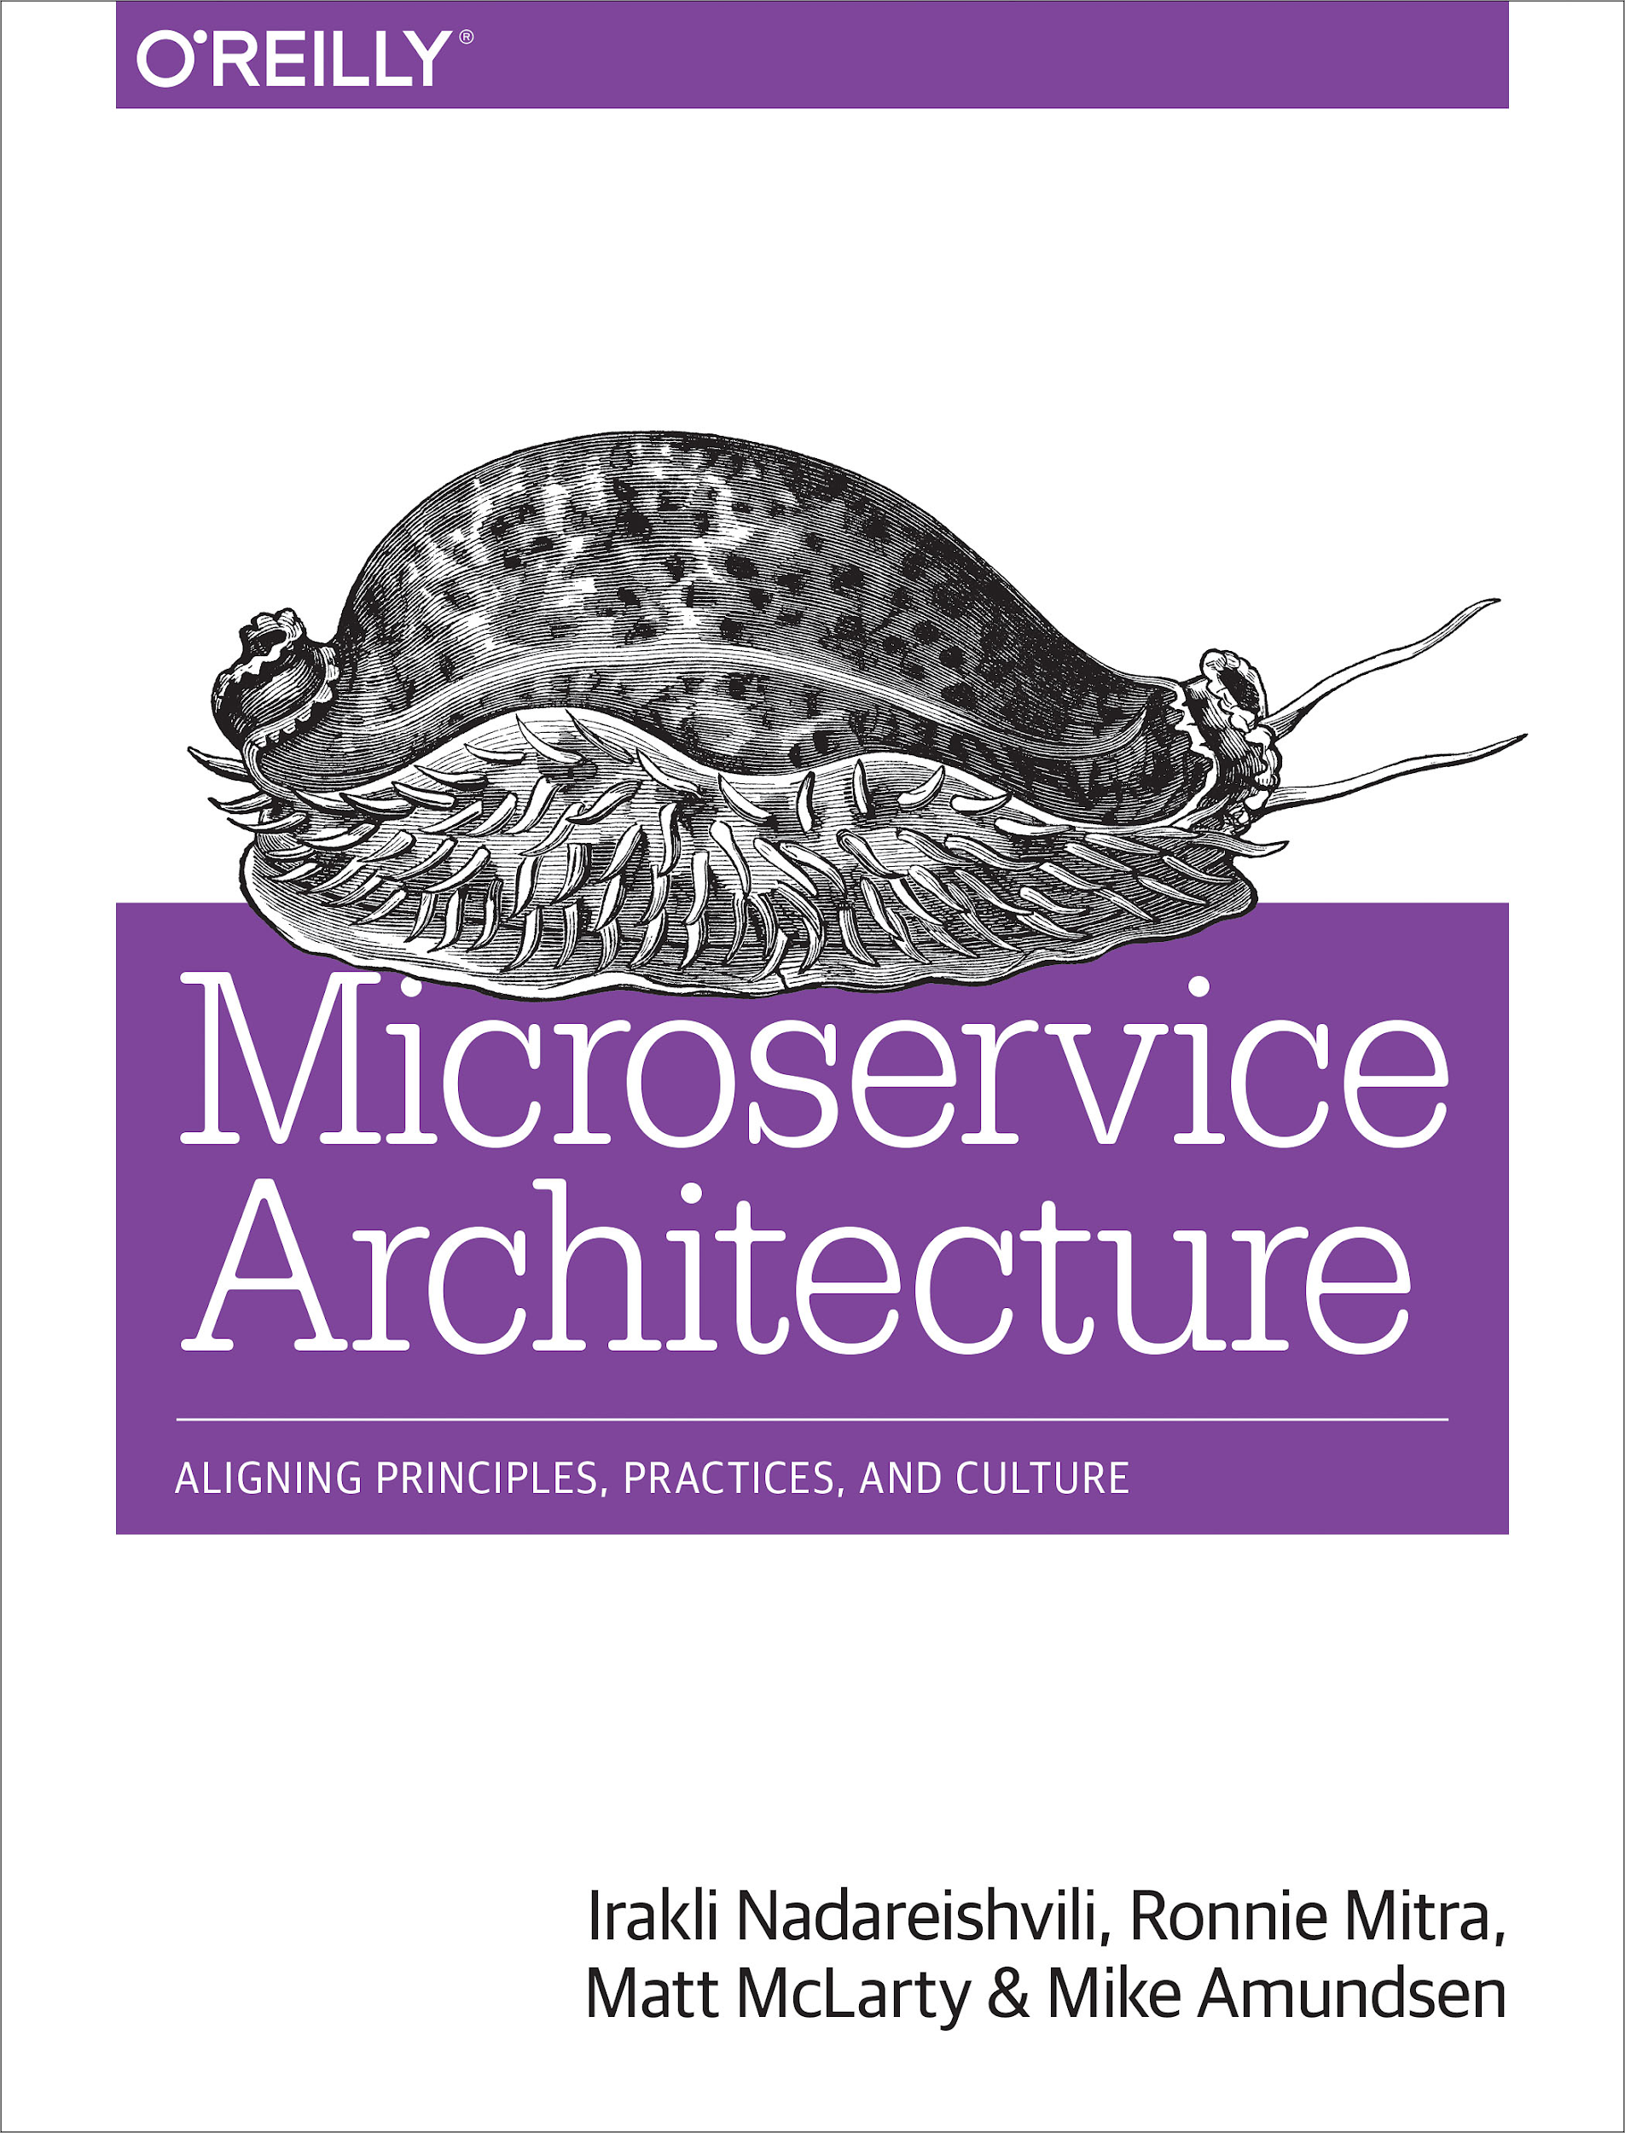
Microservices
"A microservice is an independently deployable component of bounded scope that supports interoperability through message-based communication. Microservice architecture is a style of engineering highly automated, evolvable software systems made up of capability-aligned microservices."

Slide 7
Microservices
"A microservice is an independently deployable component of bounded scope that supports interoperability through message-based communication. Microservice architecture is a style of engineering highly automated, evolvable software systems made up of capability-aligned microservices."

Slide 8
Microservices
"A microservice is an independently deployable component of bounded scope that supports interoperability through message-based communication. Microservice architecture is a style of engineering highly automated, evolvable software systems made up of capability-aligned microservices."

Slide 9
Microservices
"A microservice is an independently deployable component of bounded scope that supports interoperability through message-based communication. Microservice architecture is a style of engineering highly automated, evolvable software systems made up of capability-aligned microservices."

Slide 10
Microservices
"A microservice is an independently deployable component of bounded scope that supports interoperability through message-based communication. Microservice architecture is a style of engineering highly automated, evolvable software systems made up of capability-aligned microservices."

Slide 11
Microservices
"A microservice is an independently deployable component of bounded scope that supports interoperability through message-based communication. Microservice architecture is a style of engineering highly automated, evolvable software systems made up of capability-aligned microservices."

Slide 12
Microservices
Independently deployable
Bounded scope
Message-based
Highly automated
Evolvable

Slide 13
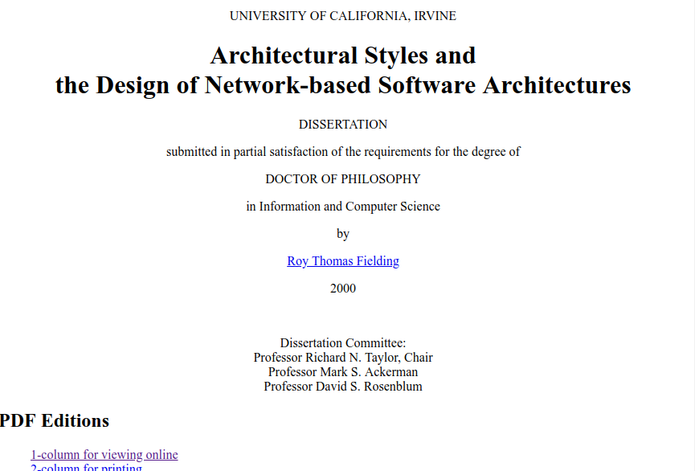
RESTful-ness
"This dissertation defines a framework for understanding software architecture via architectural styles and demonstrates how styles can be used to guide the architectural design of network-based application software."
- Fielding, 2000

Slide 14
RESTful-ness
"This dissertation defines a framework for understanding software architecture via architectural styles and demonstrates how styles can be used to guide the architectural design of network-based application software."
- Fielding, 2000

Slide 15
RESTful-ness
Notes:
Client-Server: Induces portability, scalability. Internet Scale requirement
Stateless: Induces visibility, reliability, and scalability
Cache: Induces network efficiency (performance)
Uniform Interface: Induces simplicity, visibility, evolvability. SubConstraints: addressability, representations, self-descriptiveness, hypermedia to change state
Layered System: Induces: simplicity, scalability. Internet Scale requirement
Code On Demand: Induces extensibility (OPTIONAL)

Slide 16
RESTful-ness
Properties
Performance
Scalability
Simplicity
Modifiability
Visibility
Portability
Reliability
Notes:
Client-Server: Induces portability, scalability. Internet Scale requirement
Stateless: Induces visibility, reliability, and scalability
Cache: Induces network efficiency (performance)
Uniform Interface: Induces simplicity, visibility, evolvability. SubConstraints: addressability, representations, self-descriptiveness, hypermedia to change state
Layered System: Induces: simplicity, scalability. Internet Scale requirement
Code On Demand: Induces extensibility (OPTIONAL)

Slide 17
RESTful-ness
Properties
Performance
Scalability
Simplicity
Modifiability
Visibility
Portability
Reliability
+ Requirements
Low-Entry Barrier
Extensibility
Distributed Hypermedia
Internet Scale
Notes:
Client-Server: Induces portability, scalability. Internet Scale requirement
Stateless: Induces visibility, reliability, and scalability
Cache: Induces network efficiency (performance)
Uniform Interface: Induces simplicity, visibility, evolvability. SubConstraints: addressability, representations, self-descriptiveness, hypermedia to change state
Layered System: Induces: simplicity, scalability. Internet Scale requirement
Code On Demand: Induces extensibility (OPTIONAL)

Slide 18
RESTful-ness
Properties
Performance
Scalability
Simplicity
Modifiability
Visibility
Portability
Reliability
+ Requirements
Low-Entry Barrier
Extensibility
Distributed Hypermedia
Internet Scale
= Constraints
Client-Server
Stateless
Cache
Uniform Interface
Layered System
Code on Demand
Notes:
Client-Server: Induces portability, scalability. Internet Scale requirement
Stateless: Induces visibility, reliability, and scalability
Cache: Induces network efficiency (performance)
Uniform Interface: Induces simplicity, visibility, evolvability. SubConstraints: addressability, representations, self-descriptiveness, hypermedia to change state
Layered System: Induces: simplicity, scalability. Internet Scale requirement
Code On Demand: Induces extensibility (OPTIONAL)

Slide 19
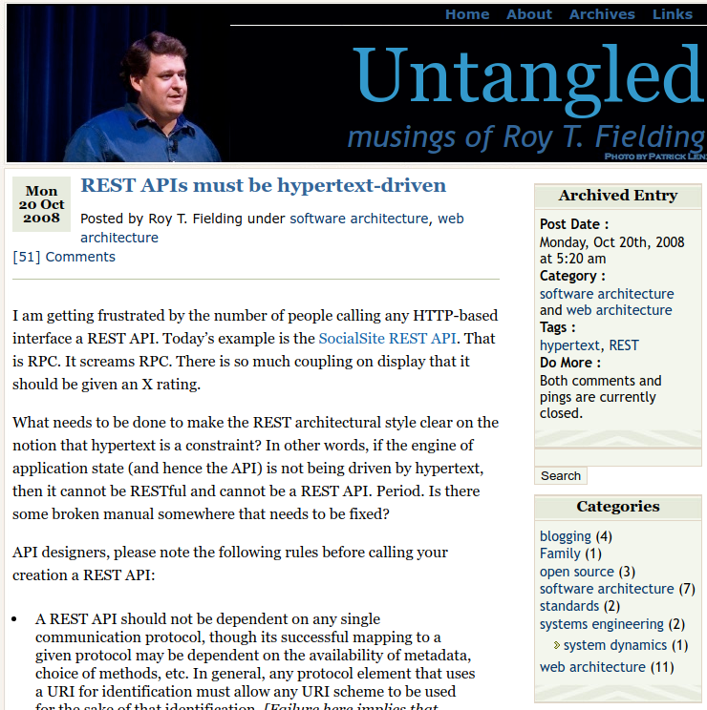
RESTful-ness
"When I say hypertext, I mean the simultaneous presentation of information and controls such that the information becomes the affordance through which the user (or automaton) obtains choices and selects actions." - Fielding, 2008

Slide 20
RESTful-ness
"When I say hypertext, I mean the simultaneous presentation of information and controls such that the information becomes the affordance through which the user (or automaton) obtains choices and selects actions." - Fielding, 2008

Slide 21
Fielding's REST ticks many of the boxes for Microservices

Slide 22
A New Kind of Service

Slide 23
Analysis Exercise

Slide 24
Models, Messages, and Vocabularies

Slide 25
Models, Messages, and Vocabularies
Models on the Inside
Messages on the Outside
Vocabularies Everywhere
Design Exercise

Slide 26
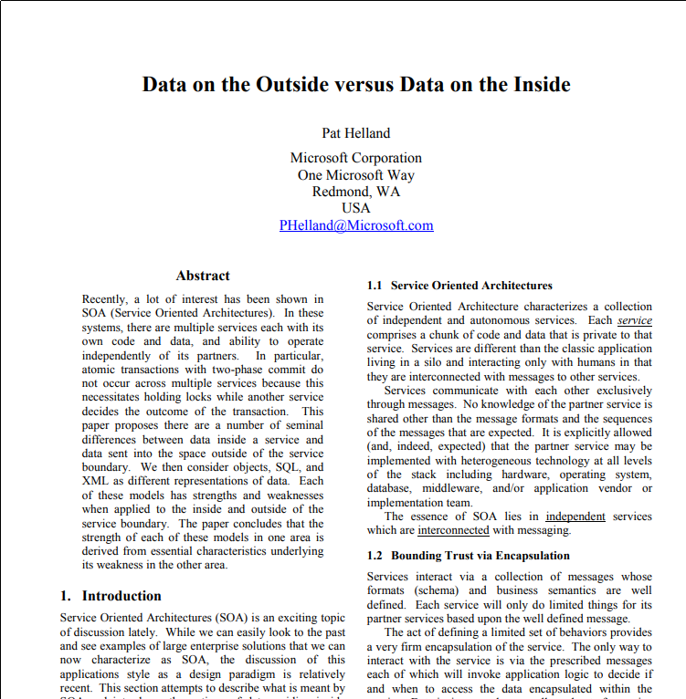
Data on the Inside vs. Data on the Outside
"This paper proposes there are a number of seminal differences between data inside a service and data sent into the space outside of the service boundary." -- Pat Helland, 2005

Slide 27
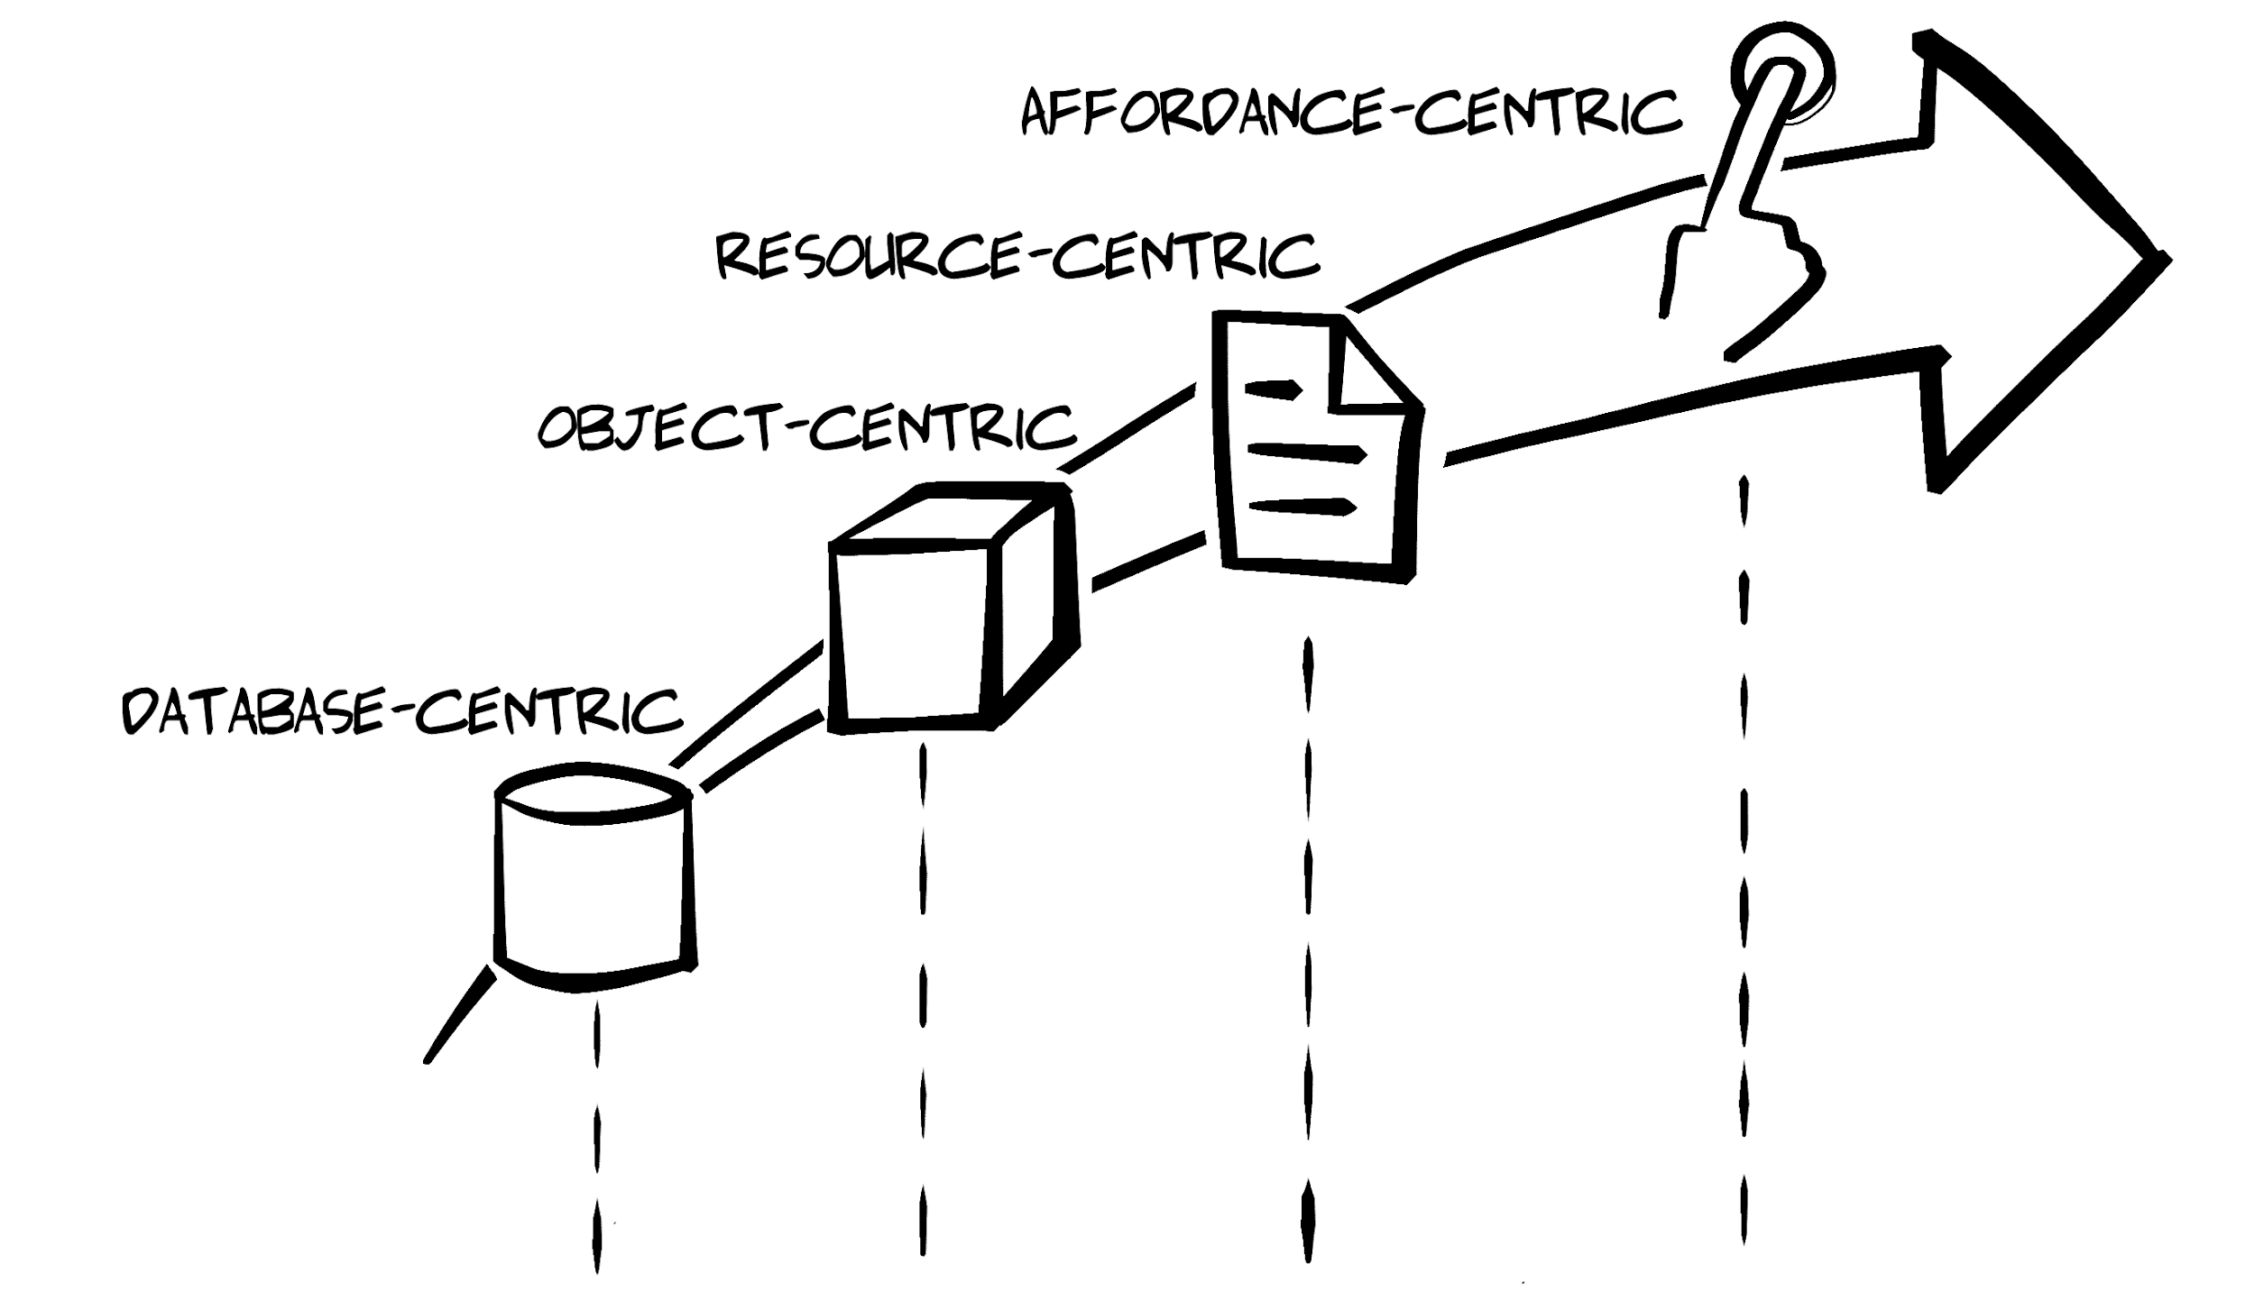
Models on the Inside
Inside is immediate, transactional
Data storage models (customers.db, orders.db)
Programming object models (objCustomer)
Inside is local, controllable
Inside relies on a shared "now"

Slide 28
Messages on the Outside
Outside is always in the past, non-transactional
Resource models (/customers/, /orders/)
Message models (customer.html, order.hal)
Outside is remote, uncontrollable
There is no shared "now"

Slide 29
If the models are different inside and out, what is shared?

Slide 30
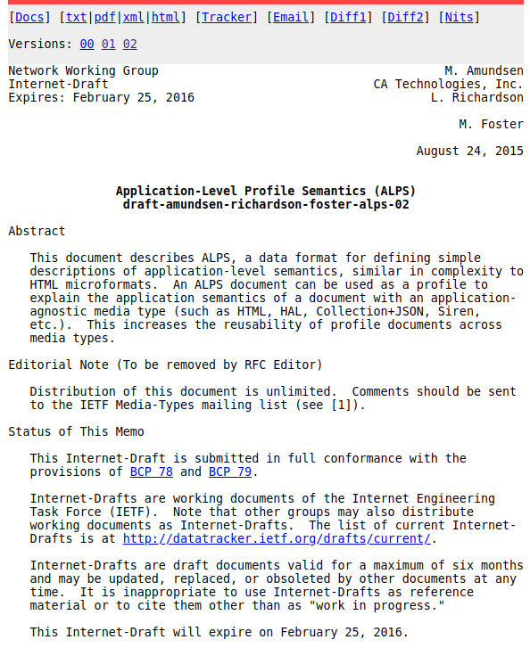
Vocabularies Everywhere
Vocabulary is how humans share (language, slang, etc.)
We use the same vocabulary for many models
Vocabularies delineate domains (medicine, IT, etc.)
IT vocabularies already exist:
Dublin Core
schema.org
microformats
IANA Link Relation Values
ALPS is a media-type and protocol independent description format

Slide 31
Design Exercise

Slide 32
BREAK

Slide 33
Runtime Service Infrastructure

Slide 34
Runtime Service Infrastructure
Advertising Services
Discovering Services
Health Checking
Discovery Exercise

Slide 35
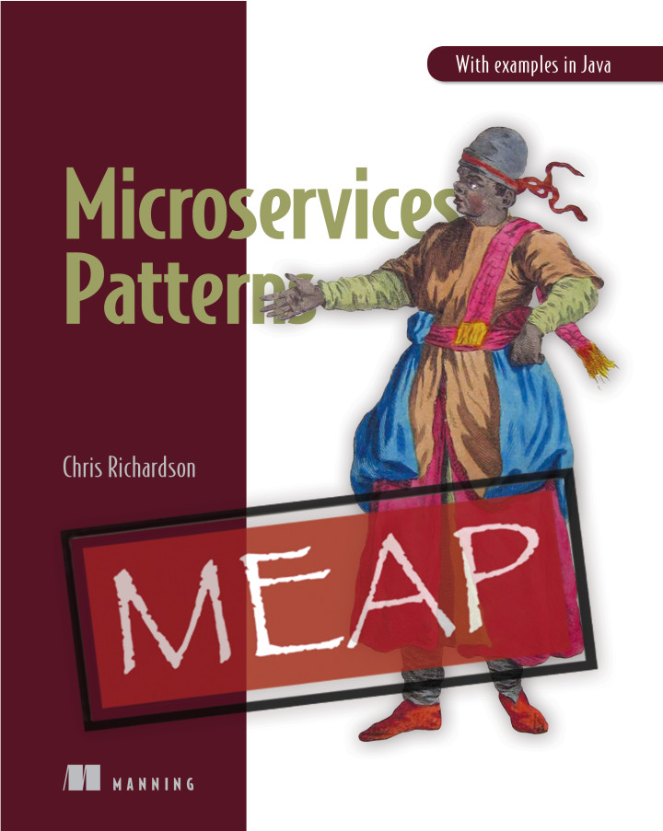
Advertising Services
"A service instance is responsible for registering itself with the service registry. On startup the service instance registers itself (host and IP address) with the service registry and makes itself available for discovery. The client must typically periodically renew its registration so that the registry knows it is still alive. On shutdown, the service instance unregisters itself from the service registry." -- microservices.io
http://microservices.io/patterns/self-registration.html

Slide 36
Advertising Services
Register upon startup
De-Register at shutdown
Renew periodically
De-Register after crashes

Slide 37
Advertising Services
CODE EXAMPLE HERE

Slide 38
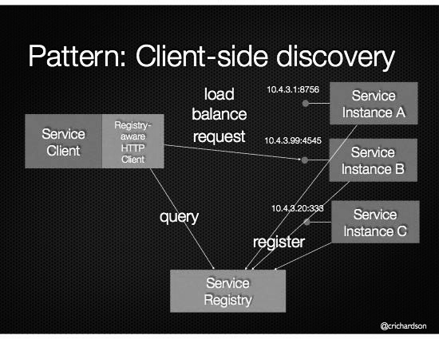
Discovering Services
When making a request to a service, the client obtains the location of a service instance by querying a Service Registry, which knows the locations of all service instances. -- microservices.io
http://microservices.io/patterns/client-side-discovery.html

Slide 39
Discovering Services
Configure client w/ registryURL
Query Registry w/ serviceName
Registry returns serviceURLport
Client uses serviceURLport
Renewal optional
http://microservices.io/patterns/client-side-discovery.html

Slide 40
Discovering Services
CODE EXAMPLE
http://microservices.io/patterns/client-side-discovery.html

Slide 41
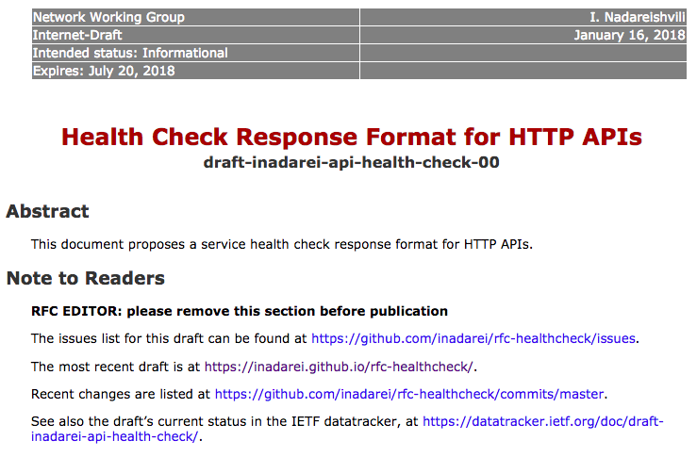
Health Checking
A service has an health check API endpoint (e.g. HTTP /health) that returns the health of the service. A health check client - a monitoring service, service registry or load balancer - periodically invokes the endpoint to check the health of the service instance.
-- microserivce.io
https://inadarei.github.io/rfc-healthcheck/

Slide 42
Health Checking
Services support health-checks
Services renew with the registry
De-reg service on failed health requests
De-reg service on expired renewals
https://inadarei.github.io/rfc-healthcheck/

Slide 43
Health Checking
CODE EXAMPLE
https://inadarei.github.io/rfc-healthcheck/

Slide 44
Discovery patterns are the DNS of application services.

Slide 45
Discovery Exercise

Slide 46
The Adaptable System

Slide 47
The Adaptable System
Service/API Designers
Evolvable Providers
Adaptable Consumers
Adaptation Exercise

Slide 48

Service/API Designers
"The value of a well-designed object is when it has such a rich set of affordances that the people who use it can do things with it that the designer never imagined."
-- Donald Norman, 1994

Slide 49
Service/API Designers
Promise message models, not object types
Document link identifiers, not URLs
Publish vocabularies, not API definitions

Slide 50

Evolvable Providers
"When people are building on top of our API, we’re really asking them to trust us with the time they’re investing in building their applications. And to earn that trust, we can’t make changes [to the API] that would cause their code to break."
-- Jason Rudolph, Github (2013)
https://www.slideshare.net/yandex/api-design-at-github-jason-rudolph-github

Slide 51
Evolvable Providers
Don't take things away
Don't change the meaning of things
Make all additions optional

Slide 52
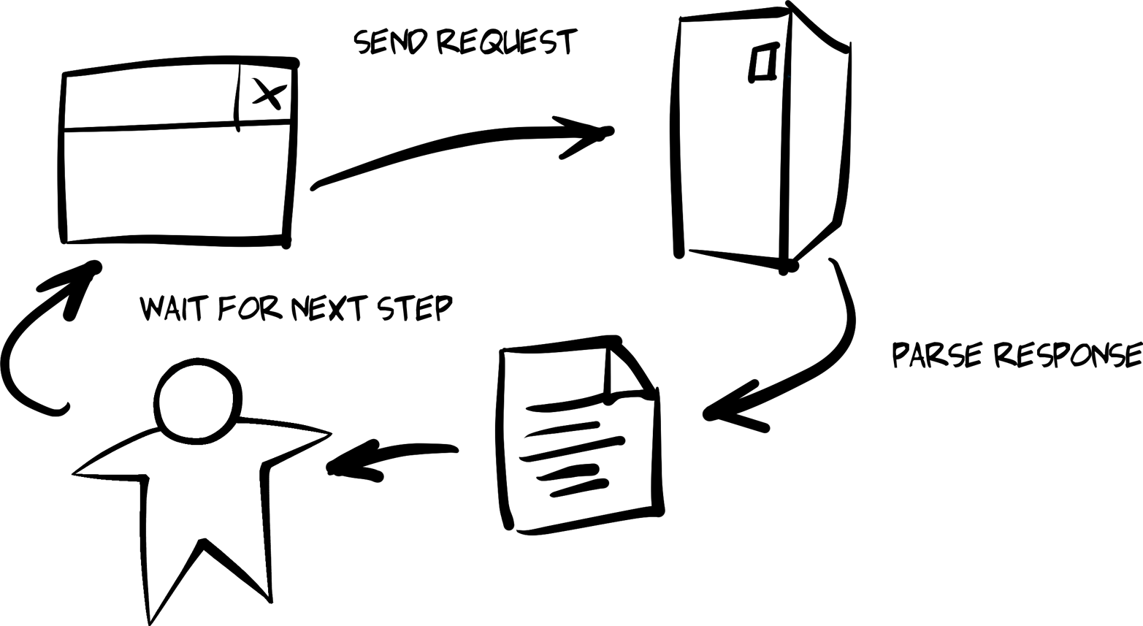
Adaptable Consumers
"When you can build a client that doesn’t have to memorize the solution ahead of time you can start building clients who are 'smart' enough to adapt to new possible actions as the service presents them." -- Mike Amundsen, 2016

Slide 53
Adaptable Consumers
Code defensively
Code to the media type
Leverage the API vocabulary
React to link relations for workflow

Slide 54
Providers evolve via humans, consumers adapt via code.

Slide 55
Adaptation Exercise

Slide 56
Summary

Slide 57
Summary
A RESTful Design
Message-Oriented Implementation
Discovery Constraints
Emergent Adaptability

Slide 58

A RESTful Design
Microservices means independent & loosely-coupled
REST properties are close to Microservice properties
Adopt hypermedia-driven services
@Fielding

Slide 59

Message-Oriented Implementation
Models on the Inside
Messages on the Outside
Vocabularies Everywhere
@PatHelland

Slide 60

Discovery Constraints
Advertising Services
Discovering Services
Health Checking/Renewals
@CRichardson

Slide 61

Emergent Adaptability
Designers promise messages
Services implement non-breaking changes
Consumers code defensively
@mamund

Slide 62
RESTful Microservices from the Ground Up
Mike Amundsen API Academy @mamund

